Slide 1


VFW Auxiliary Legislative Program Building Bridges for our Veterans and Legislators
Notes:
AI-generated content may be incorrect. ---

Slide 2

Please Don’t go……
Notes:
Purpose and Mission of the Legislative Program, Key Legislative Focus Areas for Veteran Support, How Members Can Actively Participate in Advocacy, Understanding Advocacy Boundaries and Legal Guidelines, Resources and Tools for Effective Legislative Engagement, Ways Auxiliaries Can Inspire Member Participation, Quick Steps Members Can Take Immediately, Closing Message: Commitment to Veteran Advocacy

Slide 3

Pamela Monroe 2025-2026 Department of Florida Legislative program chairman Anamcarax2@gmail.com
Notes:
This slide honors both Sailors and Air Force service members by emphasizing their vital roles and contributions to national defense. It encourages understanding and appreciation of the unique missions and challenges faced by each branch. Visuals of a navy uniform and air force aircraft reflect their service and commitment, supporting the Veterans and Legislators focus of the presentation.

Slide 4


an ADVOCATE INFORMED ENGAGED
Notes:
The purpose and mission of the VFW Auxiliary Legislative Program centers on empowering members to advocate effectively on behalf of veterans, service members, and their families through civic engagement, education, and legislative action. This initiative underscores the belief that honoring veterans means not only recognizing their service but also working to ensure their benefits, protections, and well‑being are upheld through strong public policy. At its core, the program encourages members to stay informed on key legislative issues, including healthcare access, disability benefits, transition assistance, military readiness, and national security. By understanding these topics, members can confidently communicate with lawmakers and the public about why legislative support is essential. Additionally, the program promotes awareness of how federal decisions affect veterans’ daily lives, making advocacy a responsibility shared by all members. Through this effort, Auxiliaries help build bridges between veterans’ needs and the legislative process. The mission also emphasizes active engagement—members are encouraged to learn who their Senators and Representatives are, stay current with pending bills, and use available tools like action alerts, newsletters, and legislative workshops. This proactive involvement ensures lawmakers are consistently reminded of the promises made to those who served. The program also supports community education, inviting members to share legislative updates during meetings, host informational events, and promote voter participation. By fostering a culture of awareness and advocacy within the Auxiliary, the program strengthens the organization’s ability to influence meaningful change. Ultimately, the mission reflects a commitment to standing up for veterans by shaping policies that address their needs, protect their rights, and honor the sacrifices they have made.

Slide 5
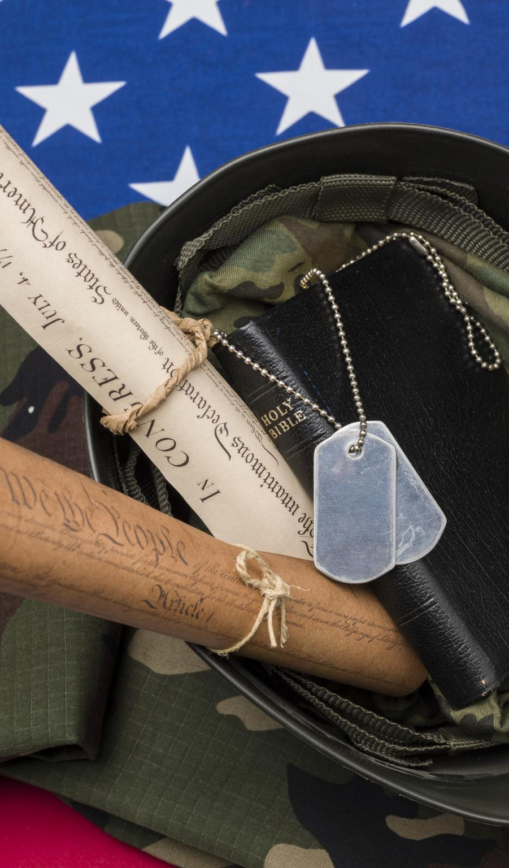
Key Legislative Focus Areas for Veteran Support
Budget
Disability Assistance & Memorial Affairs
Education, Employment & Transition Assistance
Healthcare
Military Readiness
National Security, Foreign Affairs & POW/MIA
Notes:
The legislative focus areas of the VFW Auxiliary are intentionally broad, reflecting the diverse needs of the veteran population and the complex policy landscape that shapes their benefits and quality of life. These areas begin with the federal budget, which determines how robustly veteran programs can be funded. Advocacy in this category ensures that the Department of Veterans Affairs (VA) has the necessary resources to provide timely healthcare, process disability claims efficiently, maintain medical facilities, and support long‑term care programs. Another core focus is disability assistance and memorial affairs, which address compensation for service‑connected injuries, survivor benefits, and cemetery administration. These legislative issues are crucial because they directly impact veterans living with physical or psychological injuries sustained during service. Education, employment, and transition assistance represent another priority area, ensuring veterans have equitable access to GI Bill benefits, job training programs, apprenticeships, and seamless reintegration into civilian life. Healthcare issues include expanding access to mental health services, improving VA facility staffing, addressing wait‑time concerns, and ensuring specialized care for women veterans. Military readiness involves legislation related to troop training, equipment modernization, and overall force stability, which indirectly affects veterans through long‑term national defense strategies. Matters involving national security, foreign affairs, and POW/MIA recovery emphasize America’s commitment to accountability and global leadership. These focus areas are interlinked, and by understanding them, Auxiliary members can more effectively support ongoing advocacy campaigns. Through education and engagement, members strengthen their ability to articulate why each category is vital and how improving legislative outcomes across these areas benefits veterans, families, and communities nationwide.

Slide 6
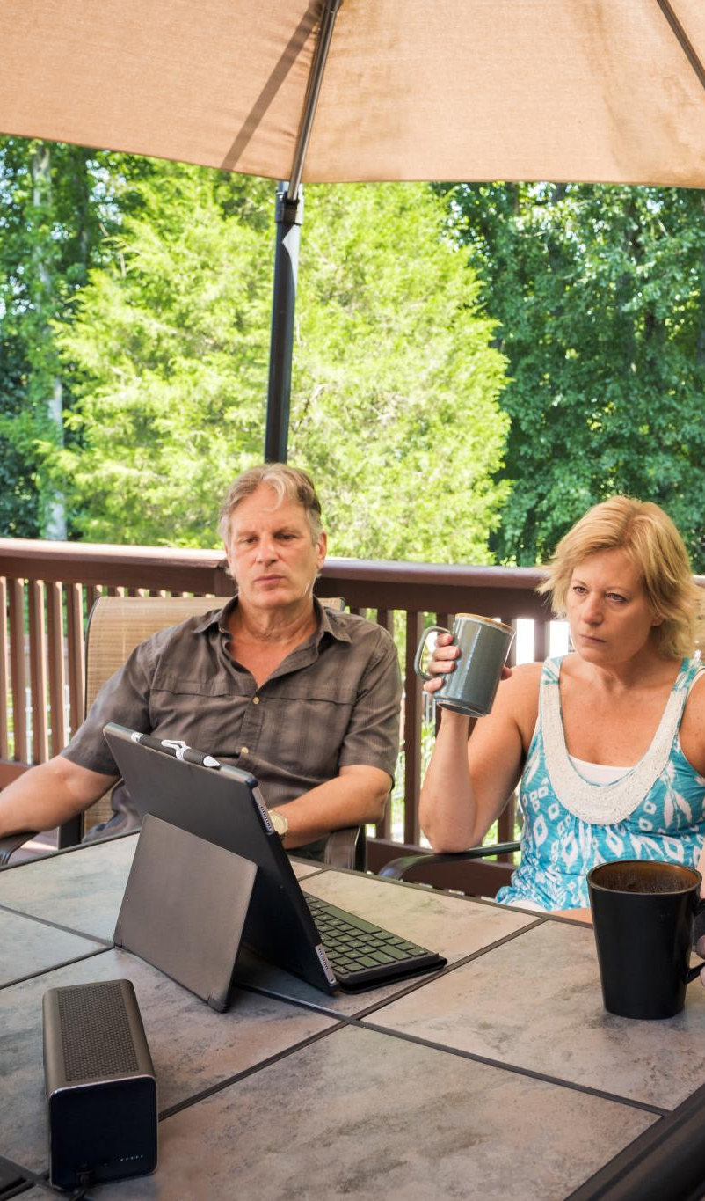
Actively Participate in Advocacy
Know your Legislators
Be aware of the issues
Subscribe to the VFW Action Corps Weekly newlsletter
When called to action respond
Take action through emails, town hall meetings, social media
Notes:
Active participation in legislative advocacy is both accessible and impactful for VFW Auxiliary members, regardless of prior experience. The first step involves learning who represents you in Congress along with understanding their voting histories, committee assignments, and positions on veteran‑related issues. This helps establish a foundation for meaningful communication. Members are highly encouraged to subscribe to legislative newsletters, particularly national Action Corps updates, which provide timely alerts about pending votes, key legislative actions, and opportunities for public engagement. When action alerts are received, members can quickly email or call their elected officials using prewritten templates or personal stories to highlight why veteran legislation matters. Attending town hall meetings gives members the chance to speak directly with lawmakers, ask informed questions, and demonstrate community‑level support for veteran causes. Members can also participate by organizing legislative moments during Auxiliary meetings, where updates are shared, bills are reviewed, and action items are identified. Hosting workshops on how to track legislation or find representatives empowers newer members to build confidence in advocacy. Encouraging family and friends to become informed expands the influence of the Auxiliary’s efforts, reinforcing the belief that everyone has a role in supporting veterans. Reporting all legislative activities to the Auxiliary ensures they contribute to departmental recognition programs and help document the collective impact of grassroots action. Through consistent engagement, members become powerful advocates, ensuring that the needs of veterans remain visible and prioritized at all levels of government.

Slide 7

Advocacy Boundaries and Legal Guidelines
Permitted Advocacy Activities
Members may support legislation, educate the public, and communicate policy needs without endorsing candidates.
Prohibited Political Actions
Endorsing candidates, wearing organizational attire at campaigns, or using resources for political promotion is forbidden.
Maintaining Nonpartisan Integrity
Following guidelines preserves the organization’s credibility and focuses influence on policy outcomes.
Ethical and Legal Compliance
Understanding boundaries ensures respectful, mission-focused advocacy that protects members and the organization.
Notes:
While members of the VFW Auxiliary are encouraged to engage deeply in legislative advocacy, it is equally important to understand the boundaries that guide appropriate and lawful political involvement. The organization differentiates clearly between issue advocacy, which is permitted, and candidate endorsement, which is prohibited. Members may support or oppose legislation, educate the public about veterans’ issues, distribute fact‑based materials, and communicate with lawmakers about policy needs. These activities align with the mission of influencing legislation that affects veterans and their families. However, members cannot endorse, promote, or oppose candidates for public office in their capacity as Auxiliary representatives. This restriction includes wearing Auxiliary attire at campaign events, displaying partisan materials during official activities, or using Auxiliary resources for political campaigning. These rules protect the organization’s nonpartisan integrity and ensure its influence remains focused solely on policy outcomes. Members should also avoid any actions that imply organizational endorsement of a candidate, even unintentionally. Understanding these guidelines promotes ethical advocacy and preserves trust with lawmakers and the public. Staying within these boundaries strengthens the credibility of the Auxiliary’s voice in legislative matters and ensures that all engagement remains mission‑focused, respectful, and legally compliant. By recognizing what is permitted and what is prohibited, members can confidently take action while protecting both their personal integrity and the reputation of the organization.

Slide 8

Ways Auxiliaries Can Inspire Member Participation
Regular Legislative Updates
Interactive Advocacy Workshops
Member Recognition and Challenges
Community Partnerships and Outreach
Notes:
Auxiliaries have numerous opportunities to inspire meaningful participation in the Legislative Program by creating an environment where advocacy feels accessible, engaging, and purposeful. One effective approach is incorporating a legislative update into every meeting, providing members with ongoing awareness of key bills and action requests. Hosting interactive workshops or demonstrations on how to find lawmakers, write effective emails, or track legislation helps members develop practical advocacy skills. Encouraging members to participate in a “Bill of the Month” challenge—where each person selects a bill, researches it, and reports back—builds confidence and accountability. Recognizing member achievements, such as contacting lawmakers or attending a town hall, reinforces the value of participation and motivates others to follow suit. Auxiliaries can also partner with local civic organizations to host joint community education events, expanding outreach and demonstrating broad support for veteran legislation. Creating informational displays, bulletin boards, or digital newsletters helps maintain ongoing visibility for legislative priorities. Leaders may assign members small, manageable advocacy tasks to ensure that everyone feels included. Additionally, involving younger generations and families fosters a culture of engagement that strengthens the Auxiliary’s future. By providing consistent encouragement, diverse opportunities, and visible recognition, Auxiliaries can nurture a strong, active base of advocates who understand the importance of legislative action and are proud to contribute.

Slide 9

Quick Steps Members Can Take Immediately
Subscribe to Action Alerts
Contact Lawmakers
Share and Engage Others through social media, Instagram, Facebook
www.votervoice.net
#AuxiliaryAmplifier
Stay Informed Locally
Notes:
Taking immediate action in support of veteran‑focused legislation is simple when members have clear, achievable steps to follow. The first step is signing up for Action Corps Weekly, which ensures members receive timely alerts on key legislative issues and opportunities to engage. This single action connects individuals to a nationwide network of advocates and provides continuous education. The next step is contacting lawmakers about at least one current bill affecting veterans. Members can use talking points from Action Corps alerts or personal testimonies to highlight why the legislation matters. Even brief communications, whether by email or phone, make a measurable impact because congressional offices track constituent contact. Sharing information with others represents the third quick step. Whether through informal conversations, social media posts, or discussions at meetings, spreading awareness increases the reach of advocacy efforts. Members can also encourage friends and family members to sign up for legislative updates, multiplying the network of engaged citizens. Reviewing local news for stories related to veteran issues can help members stay informed and ready to share relevant updates. Bringing these insights back to the Auxiliary supports group‑wide awareness and contributes to collective action. By taking these simple steps, members can begin advocating immediately, supporting legislative priorities with minimal time commitment but significant influence.

Slide 10
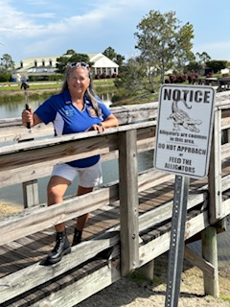
“Build Bridges for our Veterans” “From Sea to Shining See Honoring Veterans Who Keep Us Free”
Pamela Monroe
Legislative Chairman
Anamcarax2@gmail.com
Notes:
The closing message of this presentation reinforces the essential role that legislative advocacy plays in fulfilling the mission of the VFW Auxiliary. Advocacy is not just an administrative task; it is a heartfelt commitment to honoring veterans by ensuring their needs remain central in national policy decisions. Every call made, email sent, or conversation initiated about veteran legislation strengthens the nation’s promise to those who served. The impact of collective action cannot be overstated—lawmakers hear the voices of constituents, and when those voices are unified in support of veterans, real change occurs. Auxiliaries that actively engage in the Legislative Program contribute to shaping a stronger, more just system of veteran care. Members are reminded that advocacy is an ongoing journey requiring persistence, compassion, and informed action. Whether participating as an individual or as part of a larger Auxiliary effort, each member plays a critical role in keeping veteran issues visible and prioritized. By committing to stay informed, participating in legislative activities, and encouraging others to do the same, members uphold the values of service, loyalty, and respect. This dedication ensures veterans receive the recognition, care, and support they have earned. The presentation concludes with a renewed call to action: Be informed, be engaged, and continue standing up for veterans through effective, consistent advocacy.

